Slide 1
Experimental Quantum Generative Adversarial Networks for Image Generation
He-Liang Huang. et al.
2016311146 배지현
2022.11.23

Slide 2
Index
Machine learning procedure
  GAN Loss
  Parameterized quantum circuit
  Parameter shift rule
The resource-efficient quantum GAN scheme
  Quantum patch GAN
  Quantum batch GAN
Experiment
Conclusion

Slide 3
Machine learning procedure
A field of study that gives computers the ability to learn without being explicitly programmed.
Training data
Machine learning model
Error function (or loss function)
An optimization algorithm
Test data
Parameterized quantum circuit
GAN Loss
Parameter shift rule

Slide 4
GAN Loss
Optimal value for D
Jensen–Shannon divergence
https://lilianweng.github.io/posts/2017-08-20-gan/

Slide 5

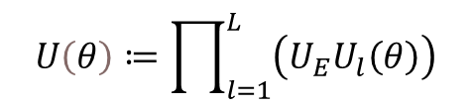
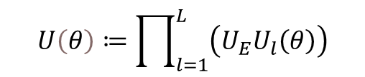
Parameterized quantum circuit
N
L ~O(poly(N))
$$U\left(θ\right)≔\prod_{l=1}^{L}{\left(U_{E}U_{l}\left(θ\right)\right)}$$
$$U\left(θ\right)≔\prod_{l=1}^{L}{\left(U_{E}U_{l}\left(θ\right)\right)}$$
$$where U_{S}∈SU\left(2\right), θ∈R^{N×L}$$
,

Slide 6
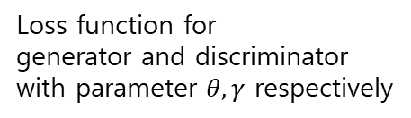


Parameter shift rule
parameterized gate
For Pauli gate a=1/2, e = $±$1
objective function f(θ) of a quantum circuit
Loss function for
generator and discriminator
with parameter $θ, γ$ respectively
update rule with learning rate $η­_{G}$
https://arxiv.org/pdf/1905.13311.pdf

Slide 7
The resource-efficient quantum GAN scheme

Slide 8

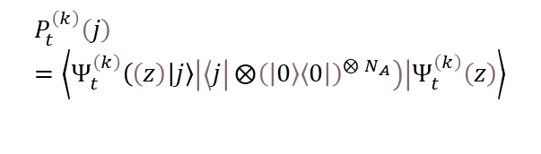

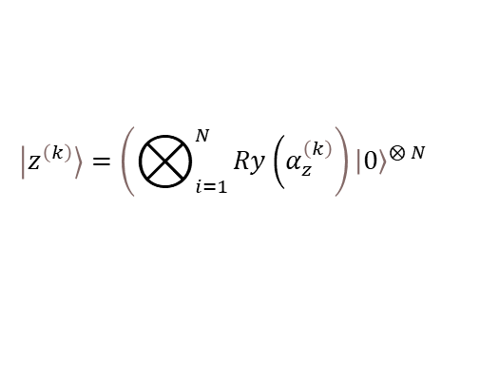
Quantum patch GAN
$$\left|Ψ_{t}^{\left(k\right)}\left(z\right)\right\rangle =U\left(θ_{t}^{\left(k\right)}\right)\left|x^{\left(k\right)}\right\rangle$$
measurement
$$P_{t}^{\left(k\right)}\left(j\right)=\left\langle Ψ_{t}^{\left(k\right)}\left(\left(z\right) | j\right\rangle \left|\left\langle j | ⨂{{\left(\left|0\right\rangle \left\langle 0\right|\right)}^{⨂{N_{A}}}}\right)\right|Ψ_{t}^{\left(k\right)}\left(z\right)\right\rangle$$
generated image
$${\tilde{x}}^{\left(k\right)}=\left[P_{1}^{\left(k\right)}, P_{2}^{\left(k\right)}, …, P_{T}^{\left(k\right)}\right] ∈ℝ^{M}$$
$$\left|z^{\left(k\right)}\right\rangle =\left(⨂_{i=1}^{N}{Ry\left(α_{z}^{\left(k\right)}\right.}\right){\left|0\right\rangle }^{⨂{N}}$$
k : k-th training iteration
t : sub-generator

Slide 9
Experiment

Slide 10
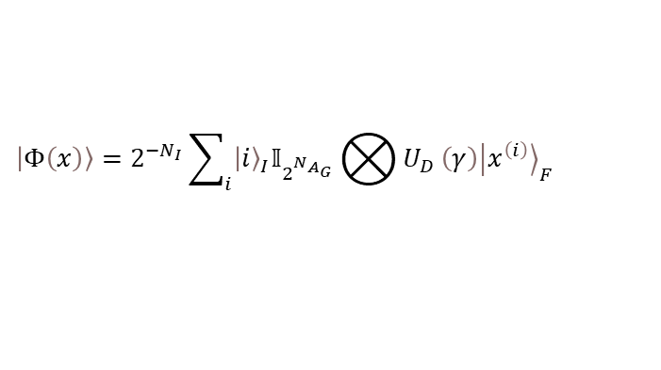
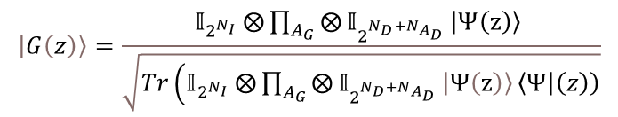
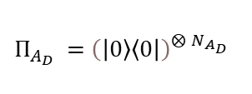
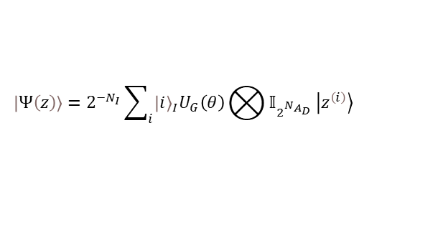

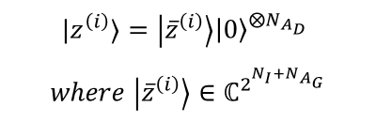
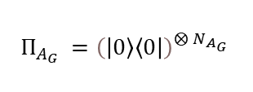
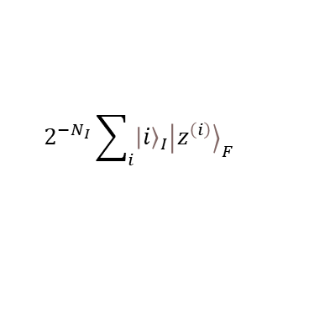
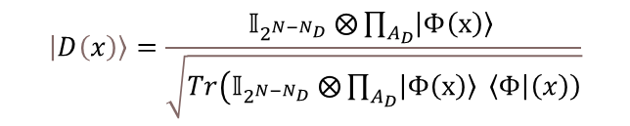
Quantum batch GAN
$$\left|Φ\left(x\right)\right\rangle =2^{−N_{I}}\sum_{i}{{\left|i\right\rangle }_{I}𝕀_{2^{N_{A_{G}}}}⨂{U_{D}}\left(γ\right){\left|x^{\left(i\right)}\right\rangle }_{F}}$$
N_{I}
partial measurement
$$Π_{A_{D}} ={\left(\left|0\right\rangle \left\langle 0\right|\right)}^{⨂{N_{A_{D}}}}$$
N_{AG}
$$\left|D\left(x\right)\right\rangle =\frac{𝕀_{2^{{N−N}_{D}}}⨂{\prod_{A_{D}}{\left|Φ\left(x\right)\right\rangle }}}{\sqrt{Tr\left(𝕀_{2^{{N−N}_{D}}}⨂{\prod_{A_{D}}{\left|Φ\left(x\right)\right\rangle }}\left\langle Φ | \left(x\right)\right)\right.}}$$
N_{D}
N_{F}
POVM
$$Π_{O} =𝕀_{2^{N−1}}\left|0\right\rangle \left\langle 0\right|$$
N_{AD}
Same for fake images G(z) instead of real images x
$$2^{−N_{I}}\sum_{i}{{\left|i\right\rangle }_{I}{\left|z^{\left(i\right)}\right\rangle }_{F}}$$
$$\left|Ψ\left(z\right)\right\rangle =2^{−N_{I}}\sum_{i}{{\left|i\right\rangle }_{I}U_{G}\left(θ\right)⨂{𝕀_{2^{N_{A_{D}}}}}\left|z^{\left(i\right)}\right\rangle }$$
partial measurement
$$Π_{A_{G}} ={\left(\left|0\right\rangle \left\langle 0\right|\right)}^{⨂{N_{A_{G}}}}$$
$${|z}^{\left(i\right)}⟩=\left|{\overline{z}}^{\left(i\right)}\right\rangle {\left|0\right\rangle }^{⨂N_{A_{D}}}$$
$$where \left|{\overline{z}}^{\left(i\right)}\right\rangle ∈ℂ^{2^{N_{I}+N_{A_{G}}}}$$
$$\left|G\left(z\right)\right\rangle =\frac{𝕀_{2^{N_{I}}}⨂{\prod_{A_{G}}{⨂{𝕀_{2^{N_{D}+N_{A_{D}}}}}\left|Ψ\left(z\right)\right\rangle }}}{\sqrt{Tr\left(𝕀_{2^{N_{I}}}⨂{\prod_{A_{G}}{⨂{𝕀_{2^{N_{D}+N_{A_{D}}}}}\left|Ψ\left(z\right)\right\rangle }}\left\langle Ψ | \left(z\right)\right)\right.}}$$
( for generating procedure )
POVM
( for training D(G(z)) )

Slide 11
Experiment
Fréchet distance

Slide 12
Conclusion
narrowing the gap between quantum and classical generative learning
  first experimental study to generate real-world digit images on a real quantum machine
reducing the number of training parameters and improving the computation efficiency in the NISQ setting
GAN is resilient to a certain level of noise sources contained in the deployed quantum device

Slide 13
Q&A

Slide 14
Fully connected neural network
z₁ = b + w₁x₁ + w₂x₂ + w₃x₃
X₁
w₁
b
h₁
h₁ = σ( z₁ )
w₂
w₃
X₂
Activate function
X₃

Slide 15
Fully connected neural network
a⁽²⁾₁
b
Back Propagation
a⁽³⁾₁
Cost(loss) function
a⁽²⁾₂
y
w₂₁
Learning Rate
w₂₂
a⁽³⁾₂
a⁽²⁾₃
w₂₃
where
y
3
3
3
3
3
3

Slide 16
Experiment detail

